Slide 1
ECE 471/571 - Lecture 16
Hopfield Network
10/27/14

Slide 2
Types of NN
Recurrent (feedback during operation)
  Hopfield
  Kohonen
  Associative memory
Feedforward
  No feedback during operation (only during determination of weights)
  Perceptron
  Backpropagation

Slide 3
Memory in Humans
Human brain can lay down and recall of memories in both long-term and short-term fashions
Associative or content-addressable
  Memory is not isolated - All memories are, in some sense, strings of memories
  We access the memory by its content – not by its location or the neural pathways
    Compare to the traditional computer memory
    Given incomplete or low resolution or partial information, the capability of reconstruction

Slide 4
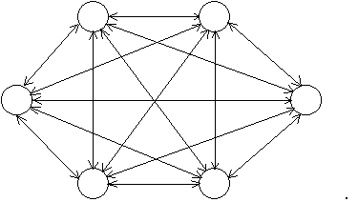

A Simple Hopfield Network
x₁
ω₁
x₂
ω₂
Σ
……
y
ω_{d}
x_{d}
-b
1
Recurrent NN
  No distinct layers
  Every node is connected to every other node
  The connections are bidirectional
16x16 nodes

Slide 5
Properties
Is able to store certain patterns in a similar fashion as human brain
Given partial information, the full pattern can be recovered
Robustness
  during an average lifetime many neurons will die but we do not suffer a catastrophic loss of individual memories (by the time we die we may have lost 20 percent of our original neurons).
Guarantee of convergence
  We are guaranteed that the pattern will settle down after a long enough time to some fixed pattern.
  In the language of memory recall, if we start the network off with a pattern of firing which approximates one of the "stable firing patterns" (memories) it will "under its own steam" end up in the nearby well in the energy surface thereby recalling the original perfect memory.

Slide 6

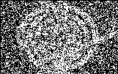

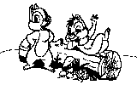
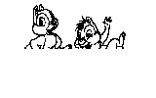
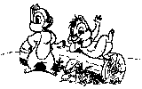
Examples
Images are from http://www2.psy.uq.edu.au/~brainwav/Manual/Hopfield.html
(no longer available)

Slide 7
How Does It Work?
A set of exemplar patterns are chosen and used to initialize the weights of the network.
Once this is done, any pattern can be presented to the network, which will respond by displaying the exemplar pattern that is in some sense similar to the input pattern.
The output pattern can be read off from the network by reading the states of the units in the order determined by the mapping of the components of the input vector to the units.

Slide 8
Four Components
How to train the network?
How to update a node?
What sequence should use when updating nodes?
How to stop?

Slide 9
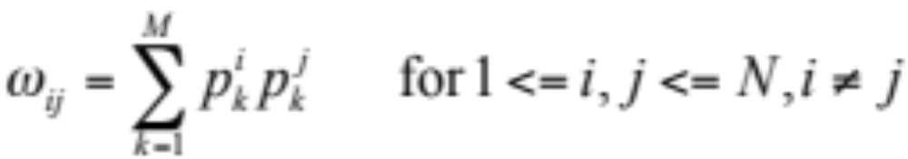
Network Initialization
Assumptions:
  The network has N units (nodes)
  The weight from node i to node j is ω_{ij}
  ω_{ij} = ω_{ji}
  Each node has a threshold / bias value associated with it, b_{i}
  We have M known patterns p_{i} = (p_{i}¹,…,p_{i}^{N}), i=1..M, each of which has N elements

Slide 10
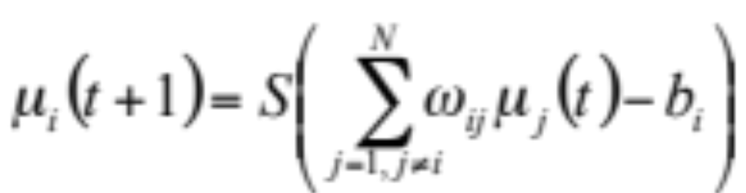
Classification
Suppose we have an input pattern (p¹, …, p^{N}) to be classified
Suppose the state of the ith node is μ_{i}(t)
Then
  μ_{i}(0) = p^{i}
  Testing (S is the sigmoid function)

Slide 11
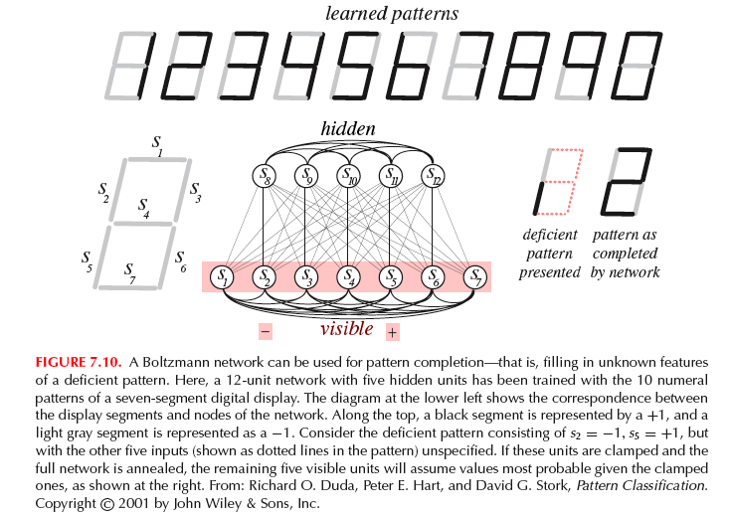

Slide 12
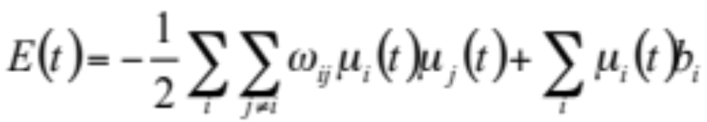
Why Converge? - Energy Descent
Billiard table model
  Surface of billiard table -> energy surface
Energy of the network
  The choice of the network weights ensures that minima of the energy function occur at (or near) points representing exemplar patterns

Slide 13
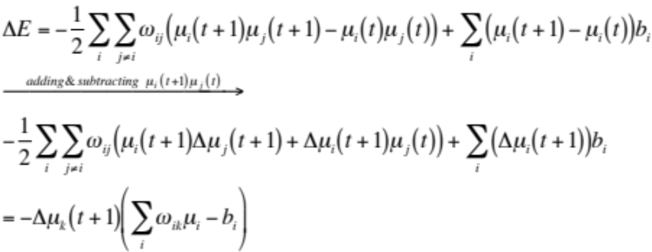
**Energy Descent

Slide 14
Reference
John Hopfield, “Neural networks and physical systems with emergent collective computational abilities,” Proceedings of the National Academy of Science of the USA, 79(8):2554-2558, April 1982
Tutorial on Hopfield Networks
http://www.cs.ucla.edu/~rosen/161/notes/hopfield.html

